Slide 1

SoundCloud
ITTalents final project

Slide 2

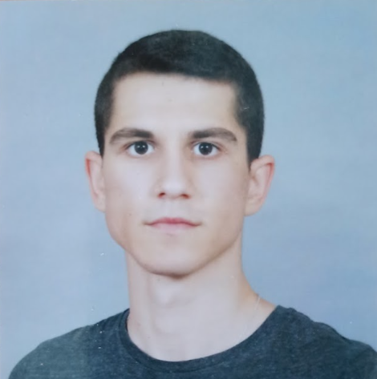
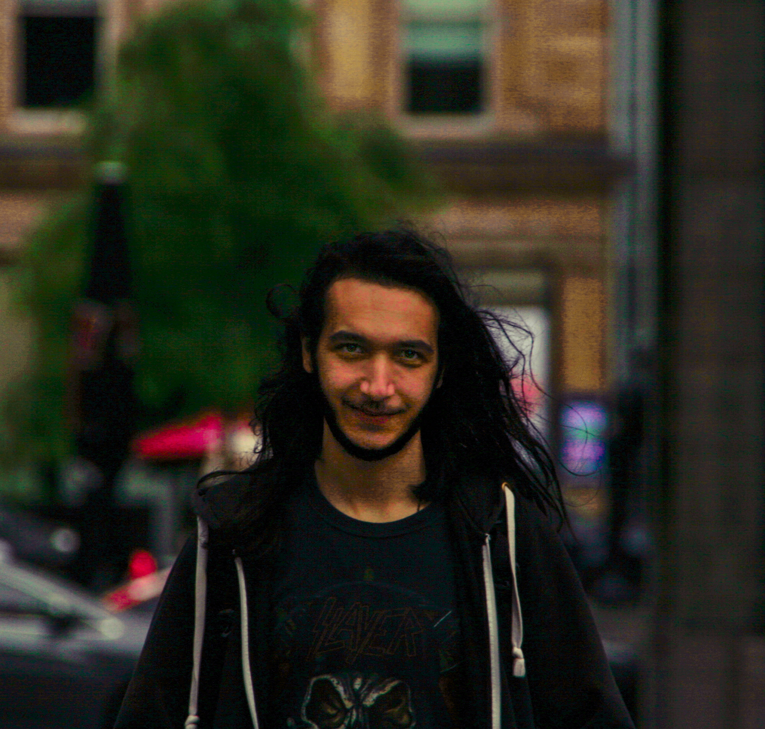
Team
Picture here
Vladimir Minchev
Alexander Ivanov
Picture here

Slide 3



















Powered by

Slide 4
Project Development Stages
18.03
You are here!
18 days
02.04
06.04
27.03
Initial commit
(DB model and Action map)
Most of User & Playlist functionality
Filter Songs & Users
Presentation
Basic Project structure
Most of Song & Comments functionality
Swagger, AWS storage, Email Confirmation
24.03
30.03
04.03

Slide 5
Key functionality and Division of labor
Vladimir
Main resources
User - 11 endpoints
register, verify token, login, follow, filter
Song - 8 endpoints
upload, download, get by user/playlist, set like/dislike
Playlist – 7 endpoints
create, add song, get by user
Comment – 6 endpoints
post, get by song/user, set like/dislike
Alexander

Slide 6
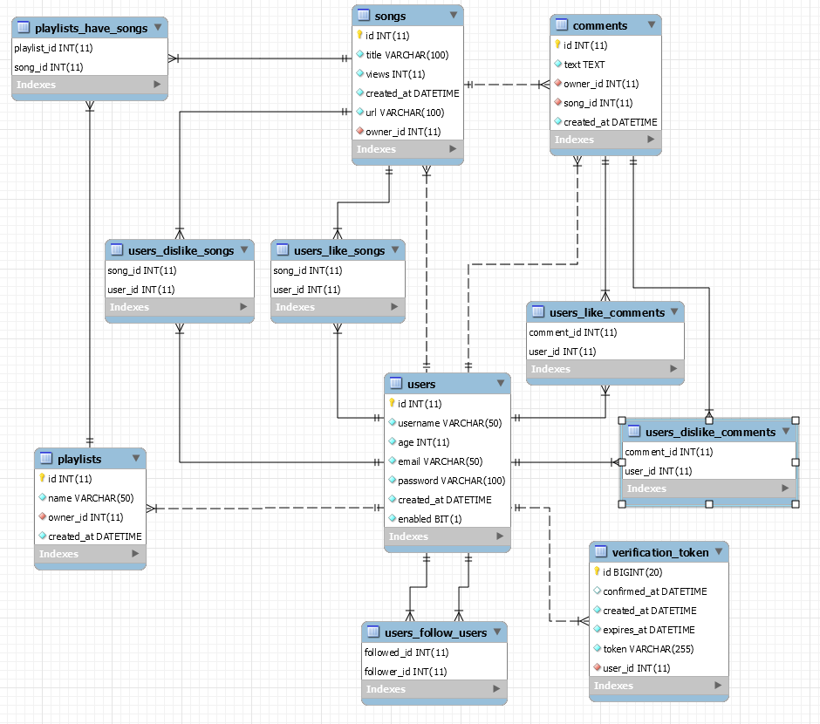
Database diagram

Slide 7
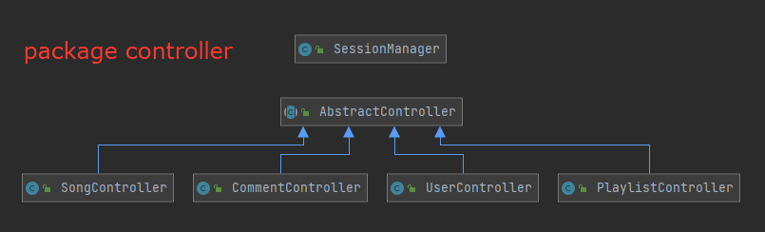
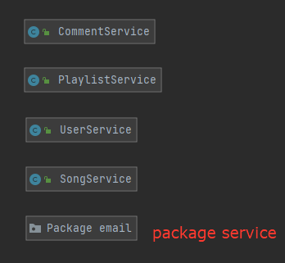
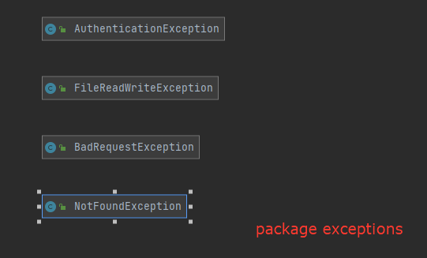
Class diagram

Slide 8
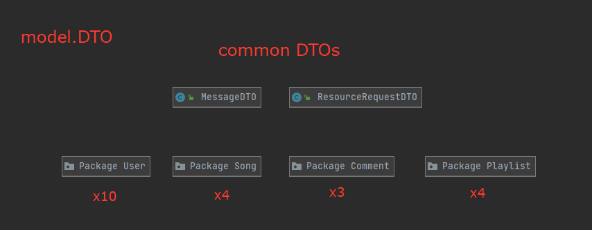
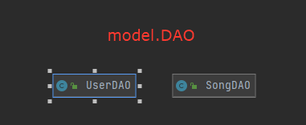
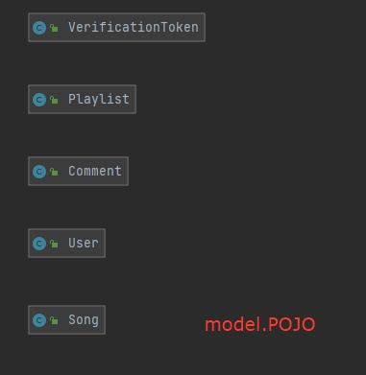
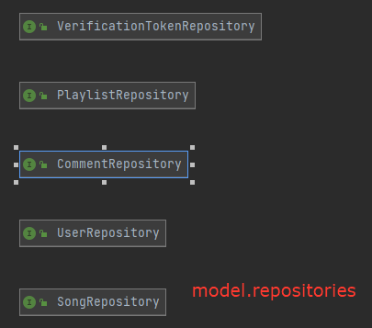
Class diagram

Slide 9

A Picture Is Worth a Thousand Words

Slide 10
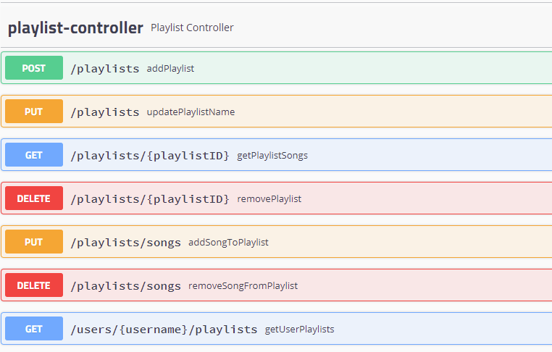
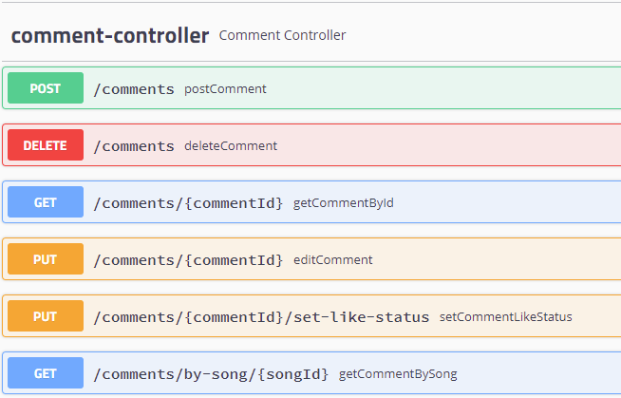
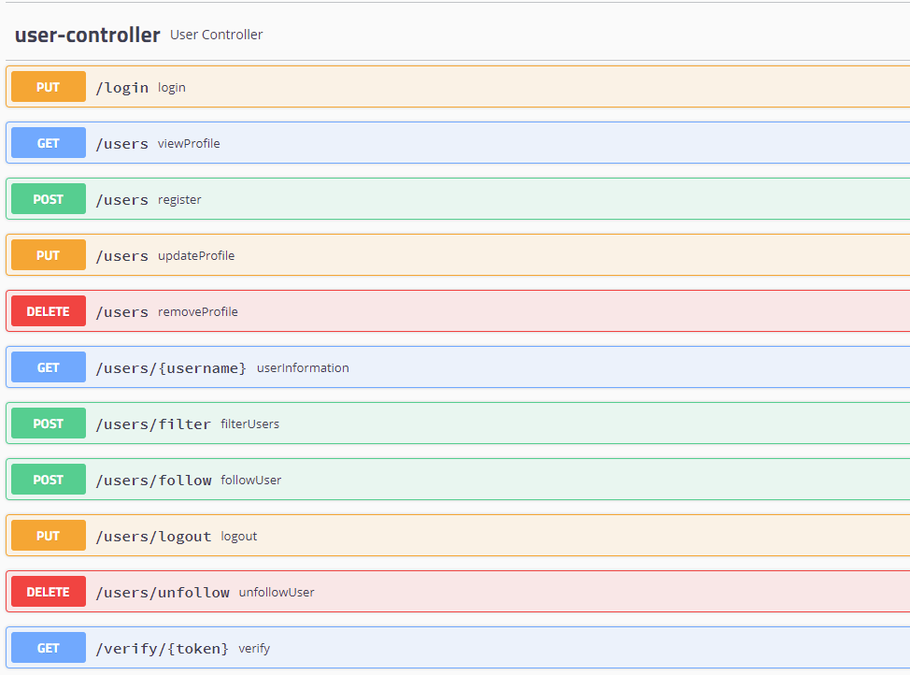
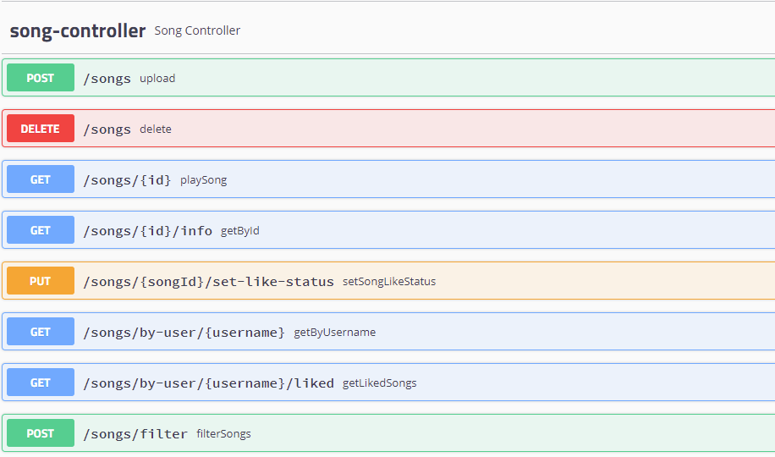
So, here are some pictures with words.

Slide 11
$0,0
Total project funding
(value-added tax excluded)

Slide 12

Project Demonstration

Slide 13
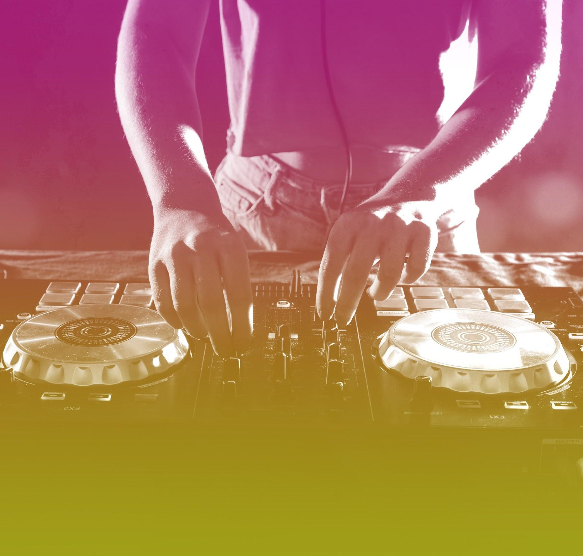
Thanks!
Do you have any questions?

